Slide 1
Small Angle Scattering Data Analysis with SasView
What SasView can do for you and what can you do for SasView?
PRESENTED BY WOJCIECH (WOJTEK) Potrzebowski

Slide 2
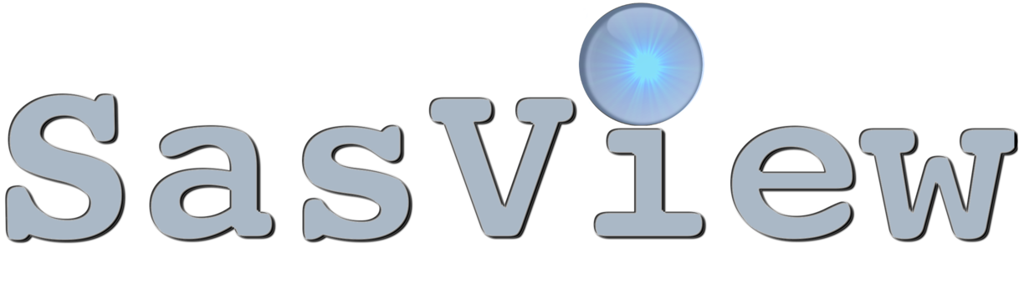
Agenda
A few topics to cover…
SAXS
SANS
Data analysis
Notes:
The one partictular challange of this presentation is to provide enough background information to the understand what SasView is good for. I’ve watched few prievious webinars from the series and I assume that audience will simillar and therefore selected this contentent. I will have to clain thoiught that I won’t be able to cover alll these topics in a great detail. The main topic of this presentation is SasView, however it cannot be discussed for general audience without introducing

Slide 3
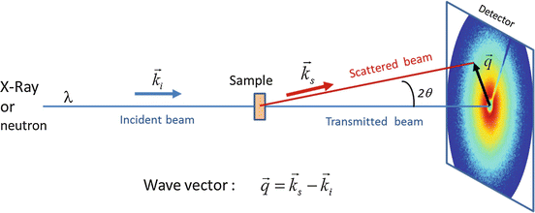
What is Small Angle Scattering?
Small-angle scattering uses X-ray (SAXS) or neutron (SANS) scattering at small scattering angles to investigate the structure at length scales from 1 - 100 nm.
Barré L. (2016) Contribution of Small-Angle X-Ray and Neutron Scattering (SAXS and SANS) to the Characterization of Natural Nanomaterials

Slide 4
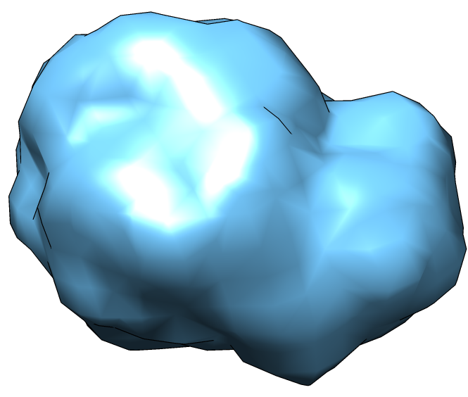
What can we learn from SAS experiment?
SAS provides information about:
Size of particle
Shape of particle
Inter-particle interactions
Orientation
Magnetic properties

Slide 5
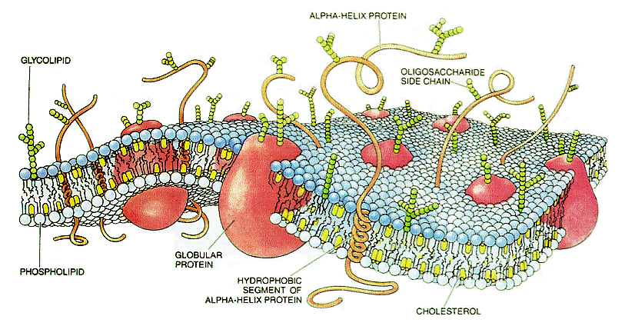
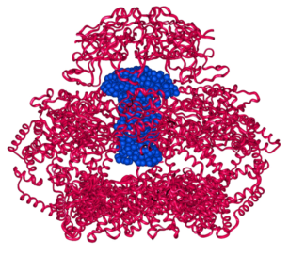
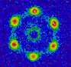
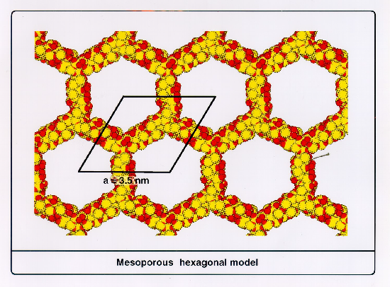
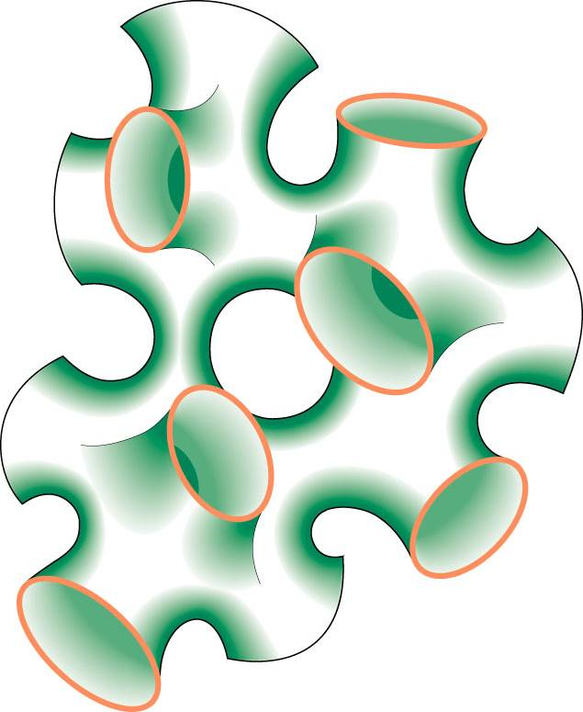
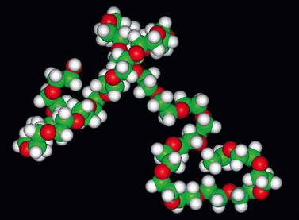
What can we study with SAXS and SANS?
SAS applications A to Z
Aerogel, alloys
Bio-macromolecular assemblies, bone
Colloids, complex fluids, catalysts
Detergents, dairy (casein micelles)
Earth science, emulsions
Fluid adsorption in nanopores, fuel cells, food science (chocolate)
Gelation, green solvents
High pressure, high temperature, hydrogen storage, helium bubble growth in fusion reactors
Implants (UHDPE)
Jelly Kinetics (e.g. of polymerization or protein folding)
keratin
Liquid crystals
Magneticflux lines, materials science
Nano-anything
Orientational order
Polymers, phase behavior, porosity
Quantum dots (GISAXS)
Rubber, ribosome
Soft matter, surfactants, switchgrass
Time-resolved, thermodynamics
Uranium separation
Vesicles, viruses
Wine science, Xylose isomerase
Yttrium-stabilized zirconia (YSZ)
Zeolites

Slide 6
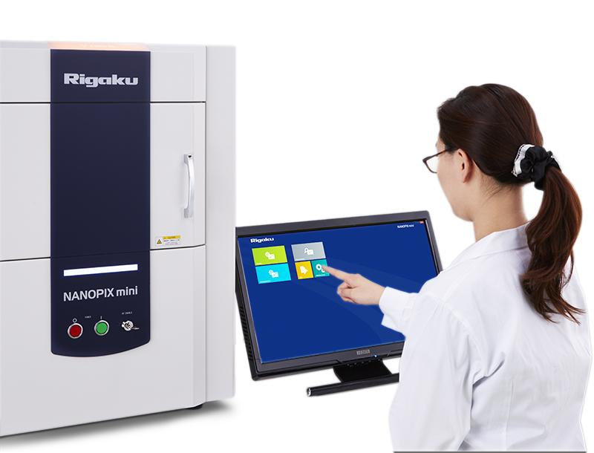
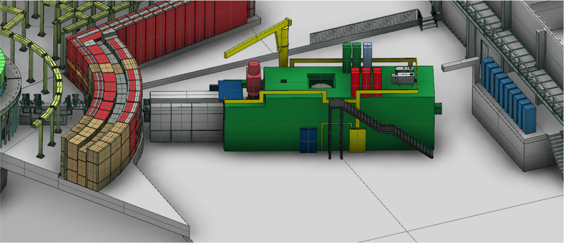
How SAXS and SANS are related?
Physics of SAXS and SANS don’t really differ, but their properties differ a great deal
X-rays
Readily available
Lab-based sources
Synchrotrons
Massive fluxes possible
Time-resolved studies
Smaller sample required (> 2.5 µl)
Neutrons
Large user facilities only
Spallation sources
Reactors
No radiation damage
Contrast variation
Larger sample required (>150 µl)
NANOPIX mini www.rigaku.com
LOKI europeanspallationsource.se
There are many experiments that really don’t require the use of neutrons.

Slide 7
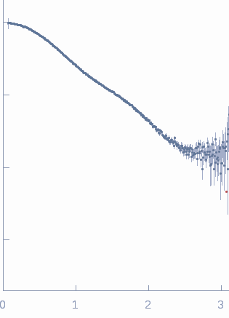
What kind of information do we get?
I(q)
q[1/nm]
1D SAS data
2D SAS data for oriented or magnetic systems

Slide 8
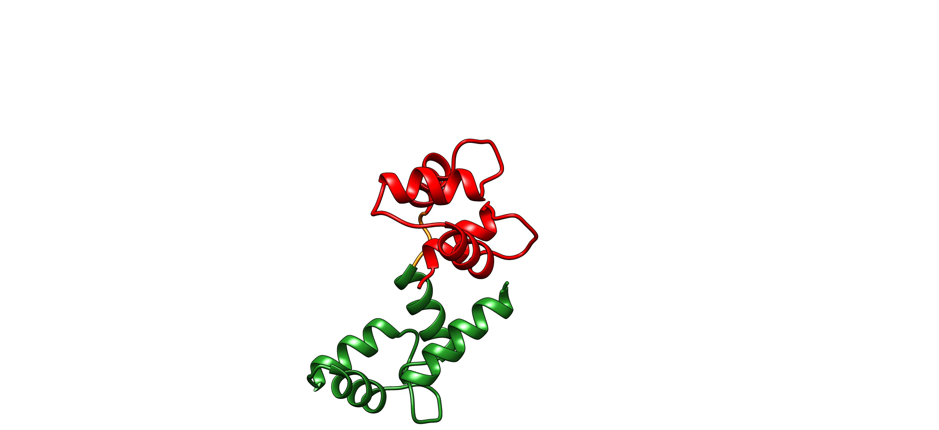
What kind of information do we get?
I(q)
q[1/nm]
Potrzebowski et al. PLOS Comp. Biol, 2018
Considerable loss of structural information!
Defining correct model is very important and the risk of overfitting to data is high!

Slide 9
Typical SAS data analysis workflow
Acquire data -> I(q)
Define a model with some free parameters
Calculate scattering pattern for that model for a given set of values for parameters
Fit the parameters so simulated data based on model matches experimental data
Credit: T. H. Rod

Slide 10
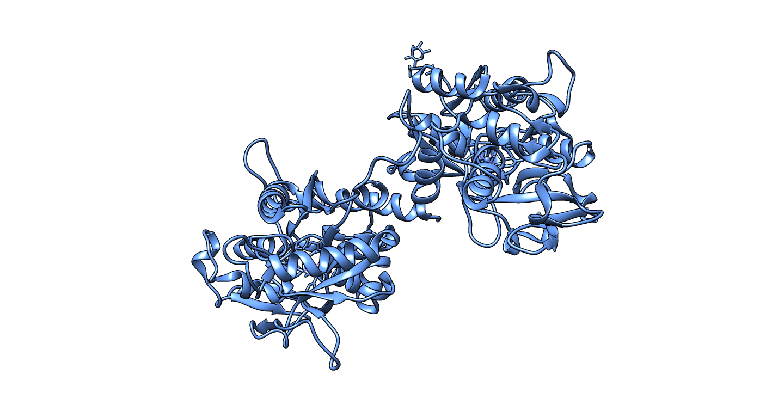
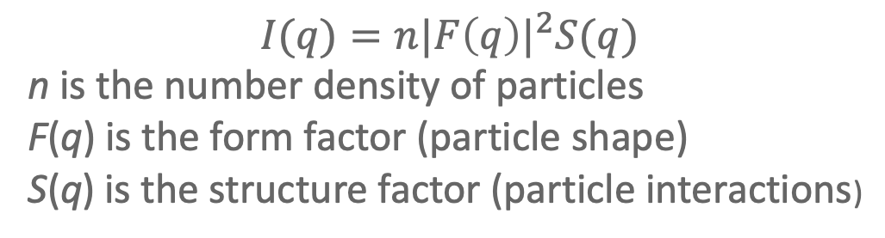
Defining model is crucial for data analysis
$$I(q)=n{|F\left(q\right)|}^{2}S(q)$$
n is the number density of particles
F(q) is the form factor (particle shape)
S(q) is the structure factor (particle interactions)
Protein structure coordinates
Cylinder radius = 40Å, lenght = 200Å
Hardsphere, effective radius = 50Å

Slide 11
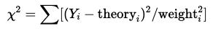
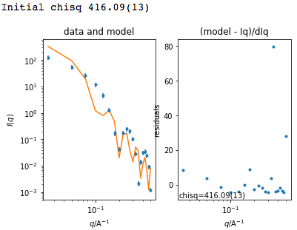
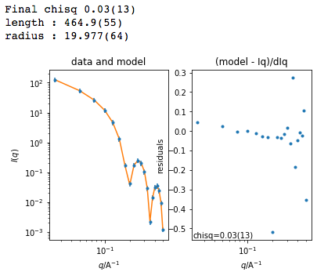
Fitting model to data is typically done through χ² optimization
 | Before fit
model
lenght | 350 Å
radius | 35 Å
 | 416.9
After fit
400 Å
40 Å
0.03

Slide 12
Typical SAS data analysis workflow
Acquire data
Define a model with some free parameters
Calculate scattering pattern for that model for a given set of values for parameters
Fit the parameters so simulated data based on model matches experimental data
Credit: T. H. Rod

Slide 13
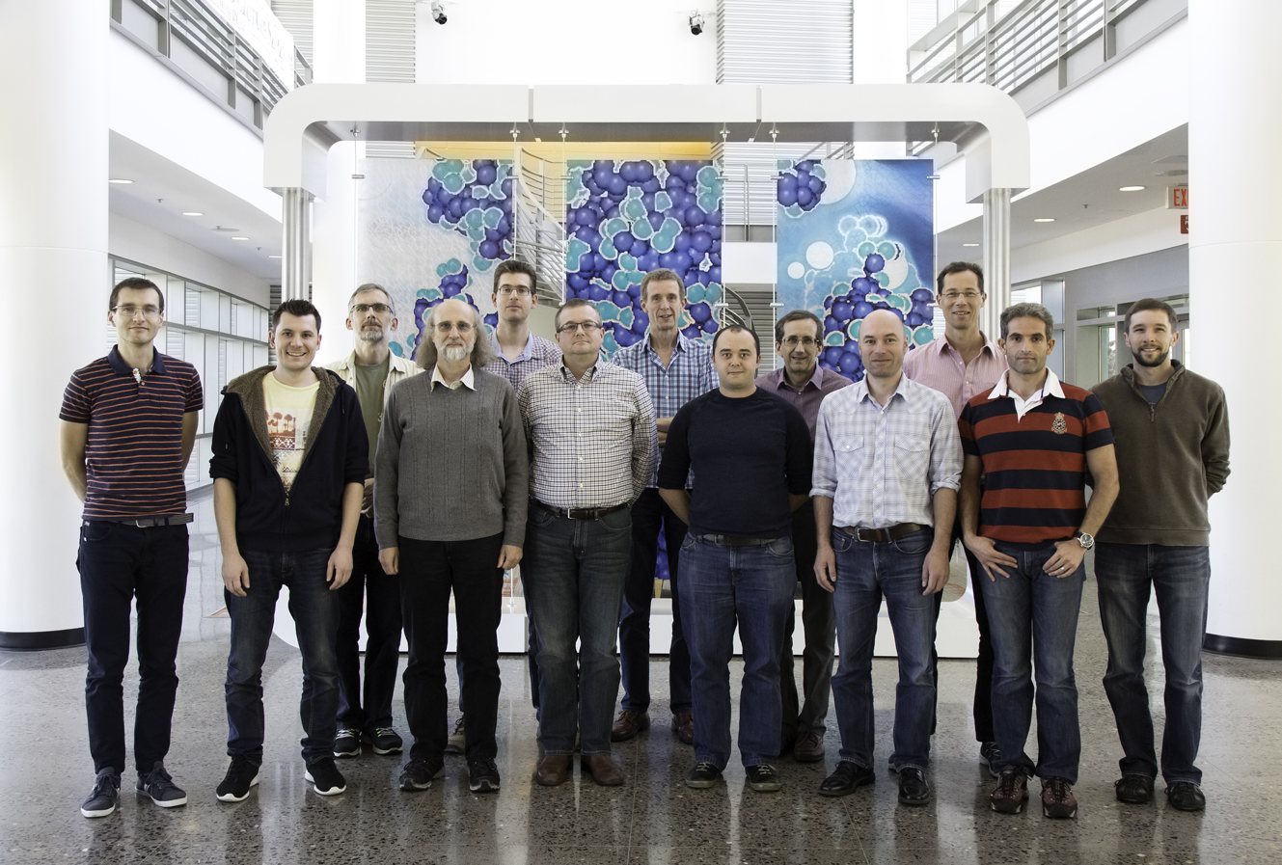
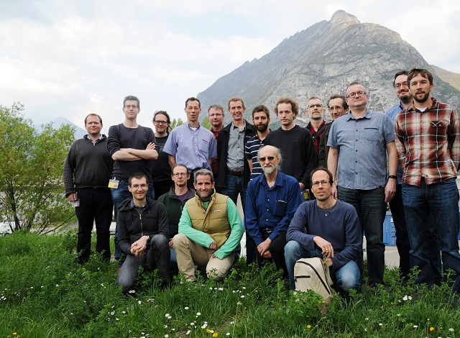
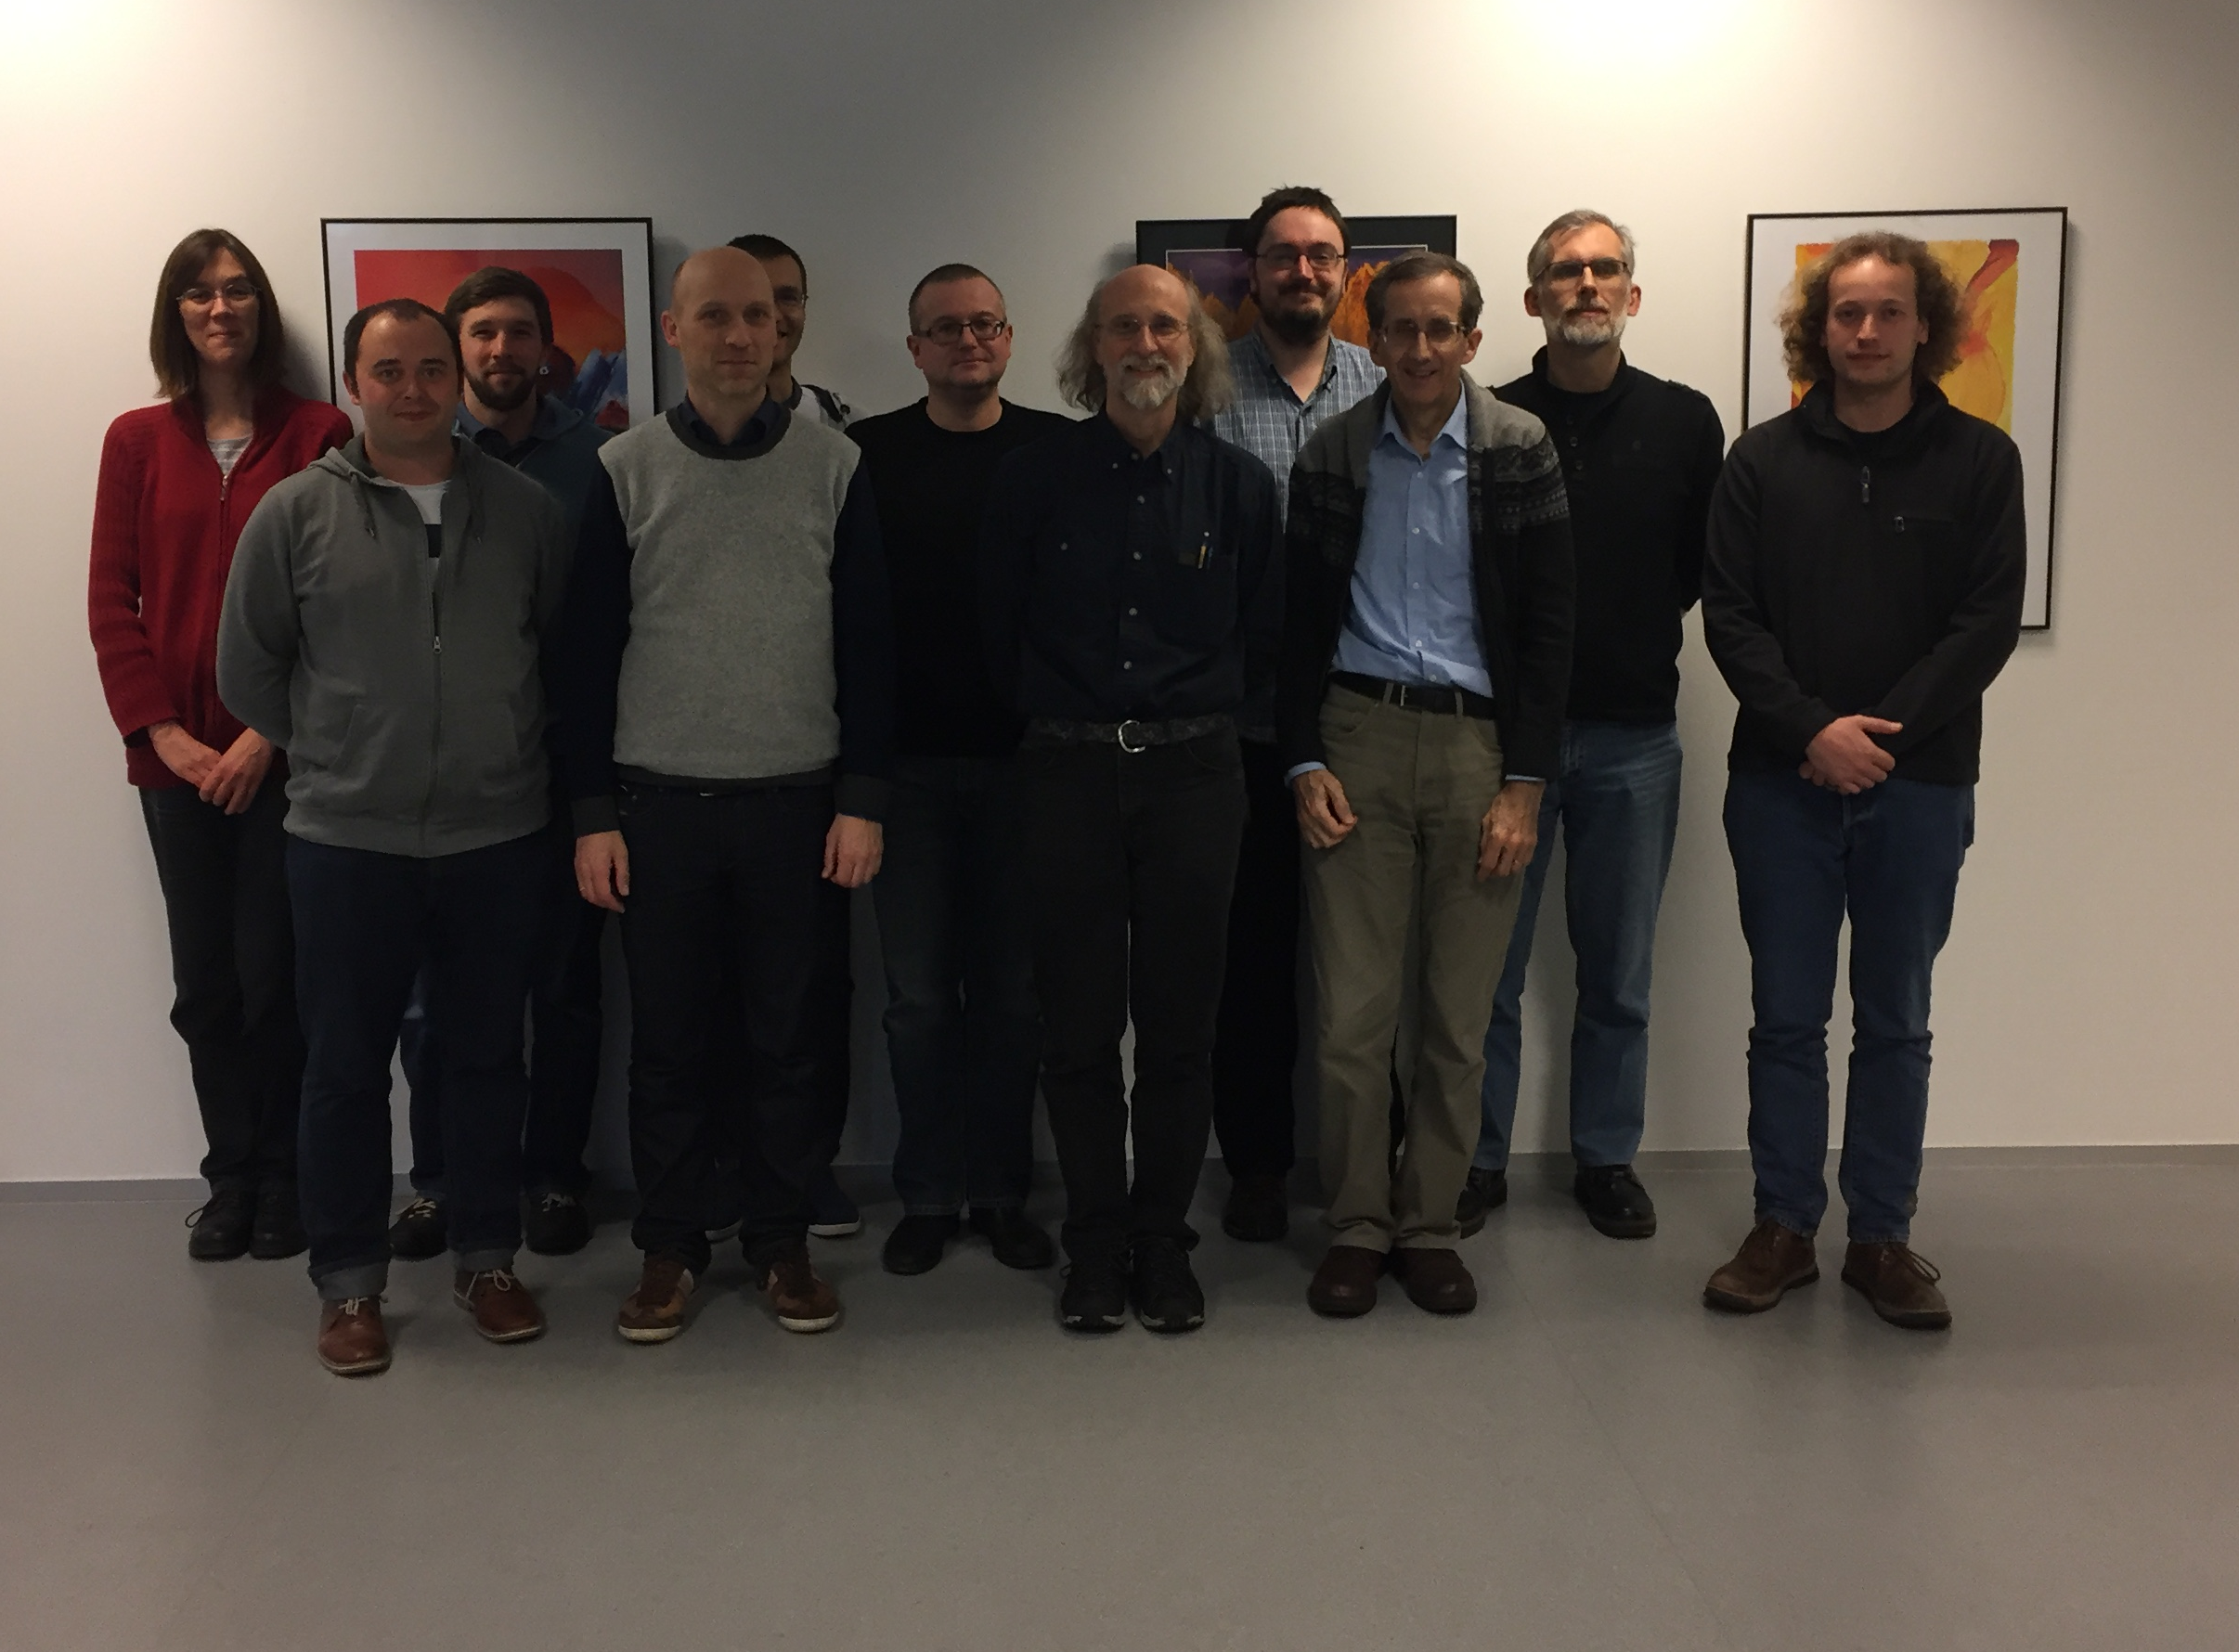
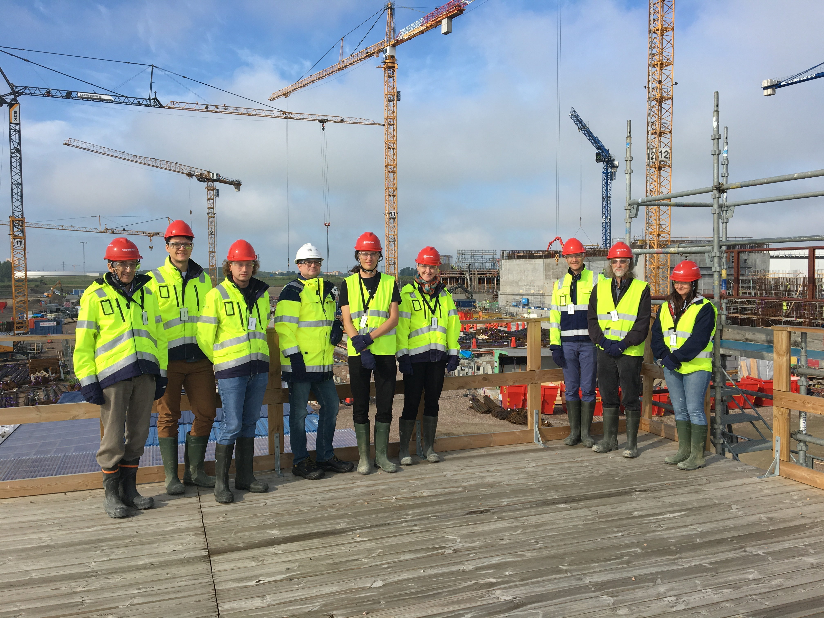
SasView history
SasView originates from NSF funded project DANSE (2006)
Turned into Community project in 2013
Supported by 9 facilities, 40 contributors (~15 active at any one time)
Management: P. Butler (NIST), M. Doucet (ORNL), A. Jackson (ESS), S. King (ISIS)
Biweekly calls
Regular “camps”
Paul Butler (NIST), Stephen King (ISIS), Nicolas Martinez (ILL) have joined this webinar
Pictures from Code Camps: V, VI, VII, VIII

Slide 14
Who are we?
SasView ecosystem
Physics
Computer Science
Chemistry
Structural Biology
Math/Statistics
Coding
Documentation and tutorials
Computer administration
Project management
Theory
Education and outreach
Coding is only part of the project!

Slide 15
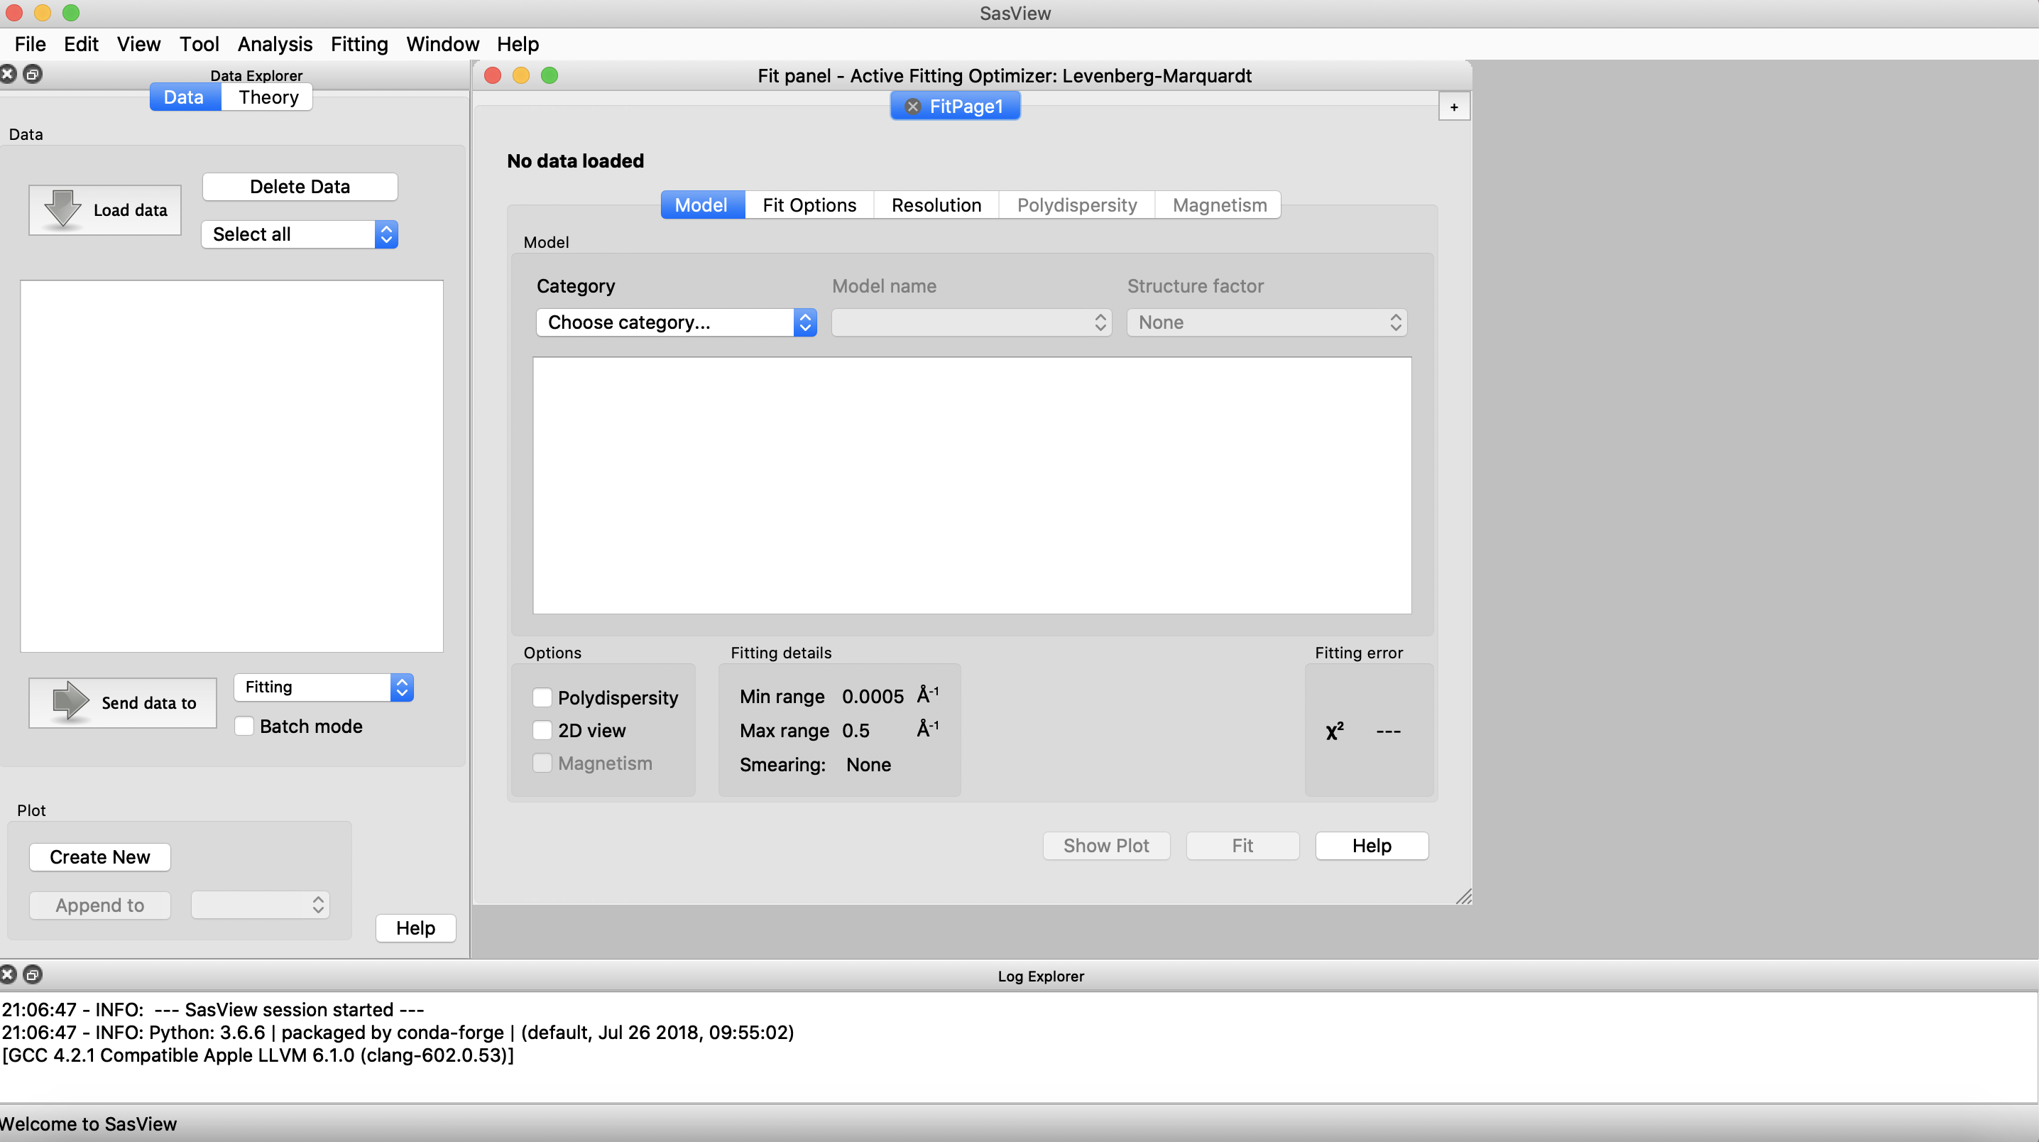
Welcome to SasView

Slide 16
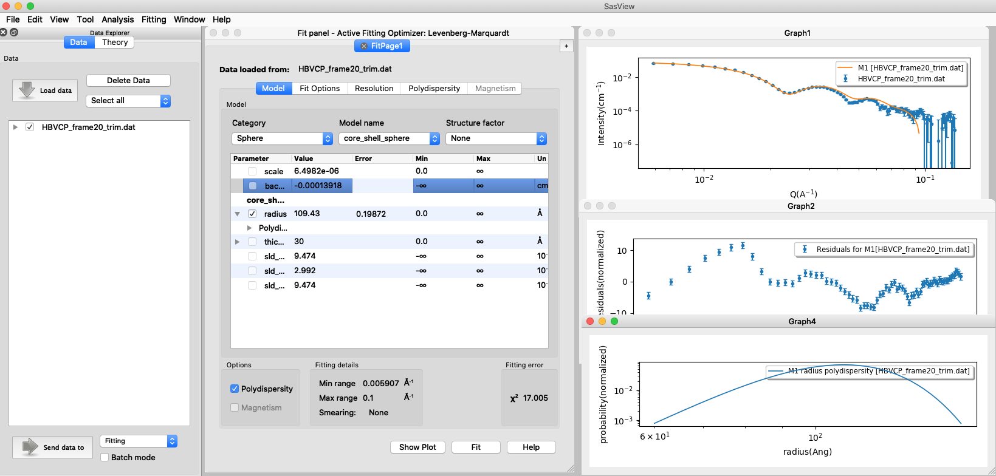
70+ models to explain 1D data
SasView in action
Wide choice of built-in models (> 70)
F(Q), S(Q) & F(Q)*S(Q)
Single, batch and simultaneous fitting
Data management
Common data formats supported, including NXCansas & cansas1D
Analysis Tool Choice
&
Plotting
Polydispersity (choice of distribution and distribution parameters)
Resolution smearing (pinhole and slit)
Automatically from data or provide parameters

Slide 17
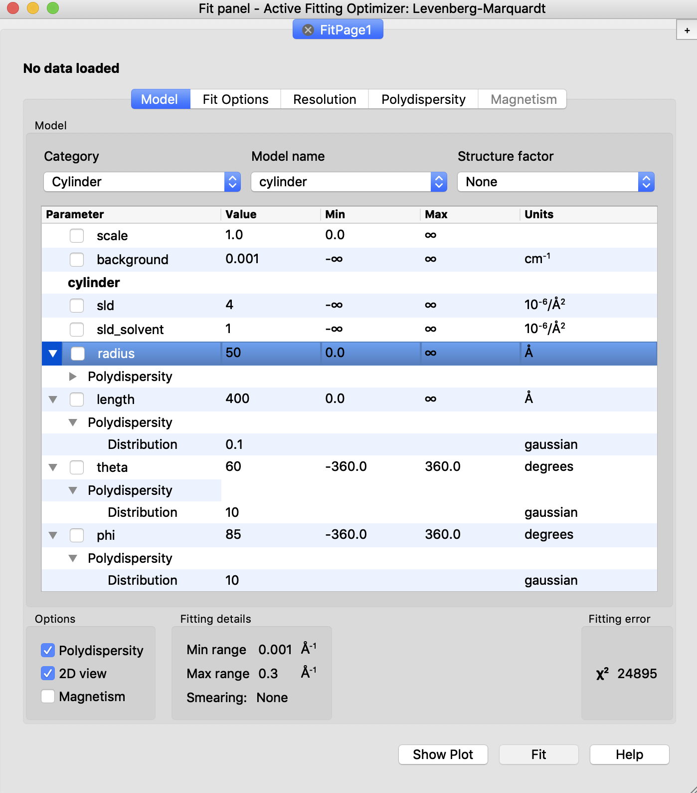
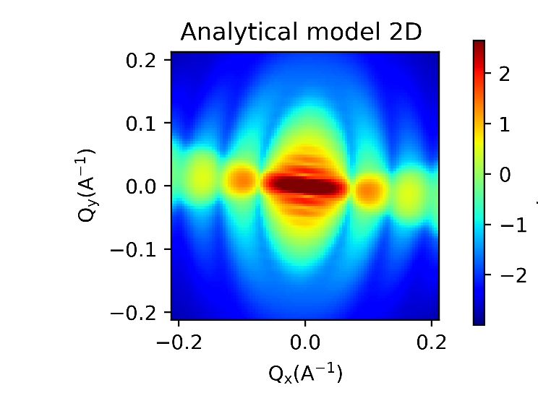
2D analysis can be performed fast
Orientational polydispersity = “jitter”
Decouples the frame for the object’s orientation with respect to the beam and the “jitter” around the axis of the object.
Turning on GPU Option highly recommended for 2D fitting

Slide 18
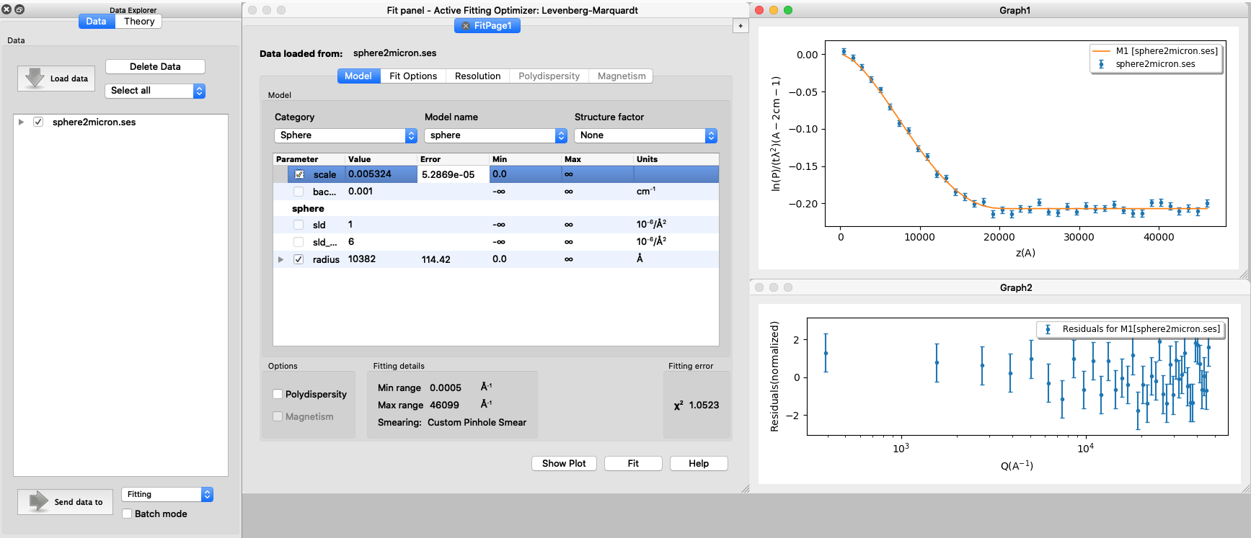
SasView can analyze SESANS data
SESANS measures structures of materials (20nm-20µm) in real space
Automatic Hankel Transform of SANS models

Slide 19
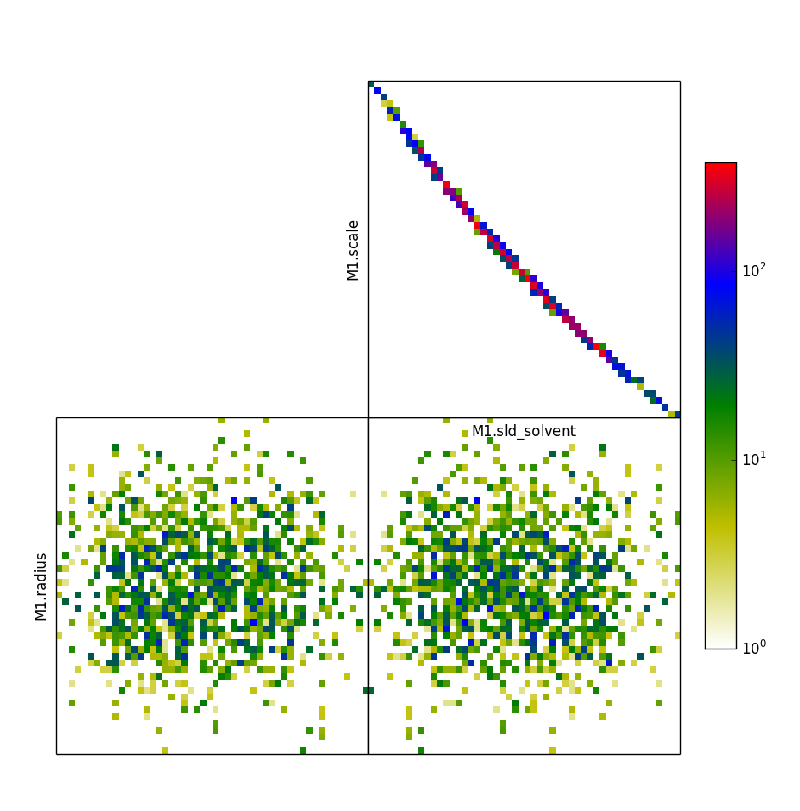
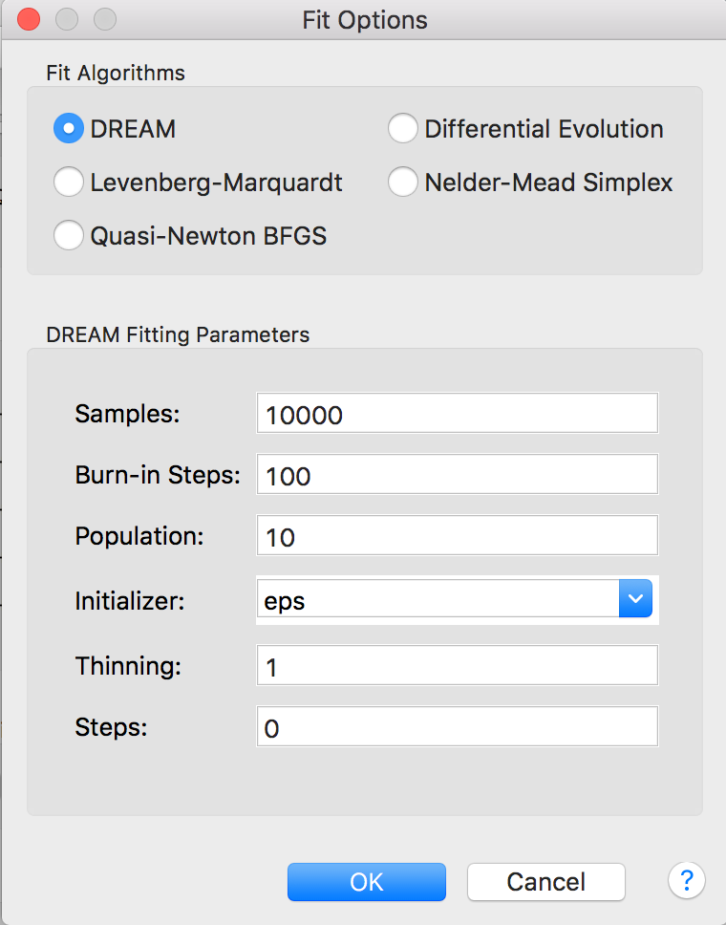
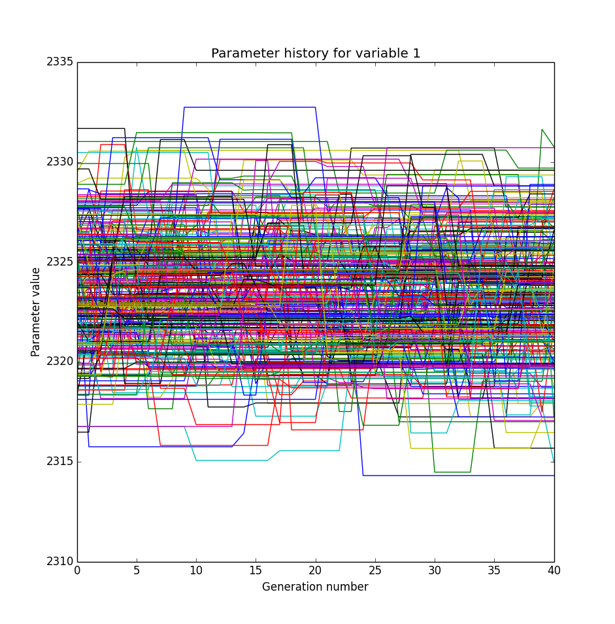
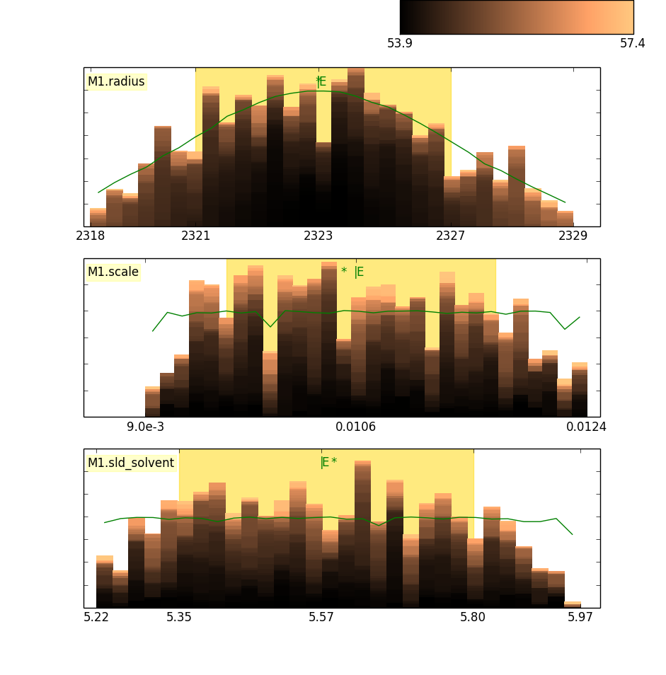
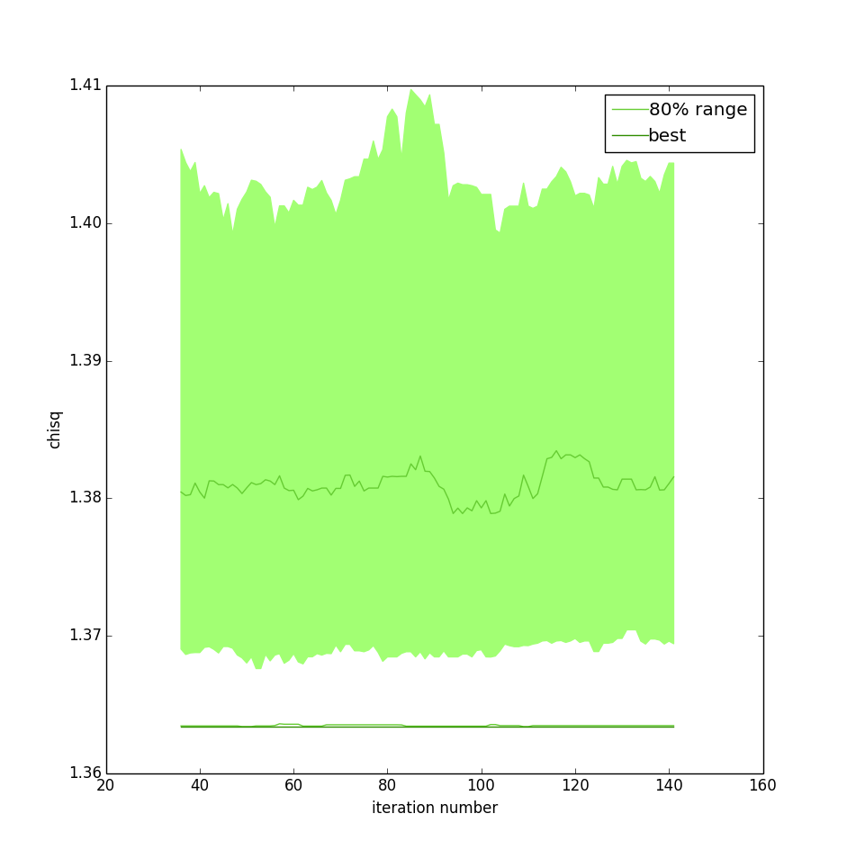
Integration with bumps enables multiple fitting engines
Conventional and Bayesian optimization
Uncertainty estimation of inferred parameters
Parameters correlations
Uses bumps package from P. Kienzle

Slide 20
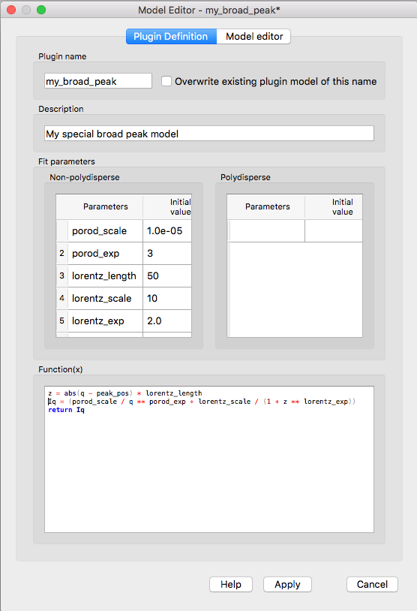
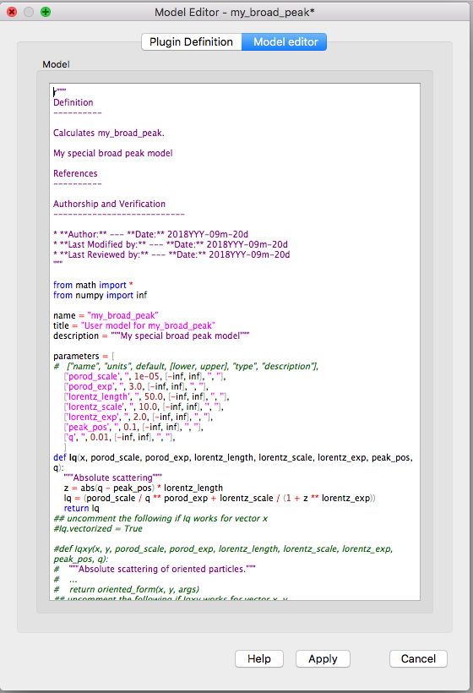
It is easy to add plugin models
Easy to develop custom models
Syntax and performance testing
Directly available in SasView ecosystem

Slide 21
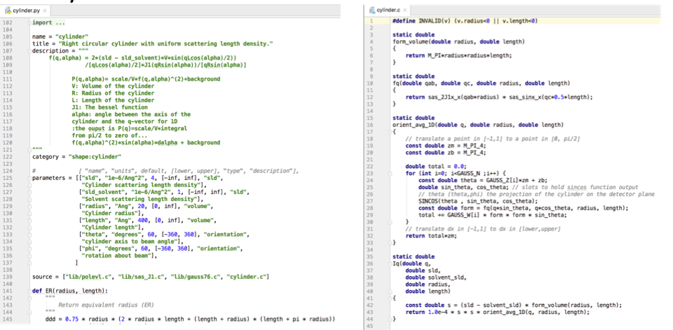
And execute them fast...
SasView supports python and c files
Performance optimization (GPU and multi-core)
Full model description
Unit testing

Slide 22
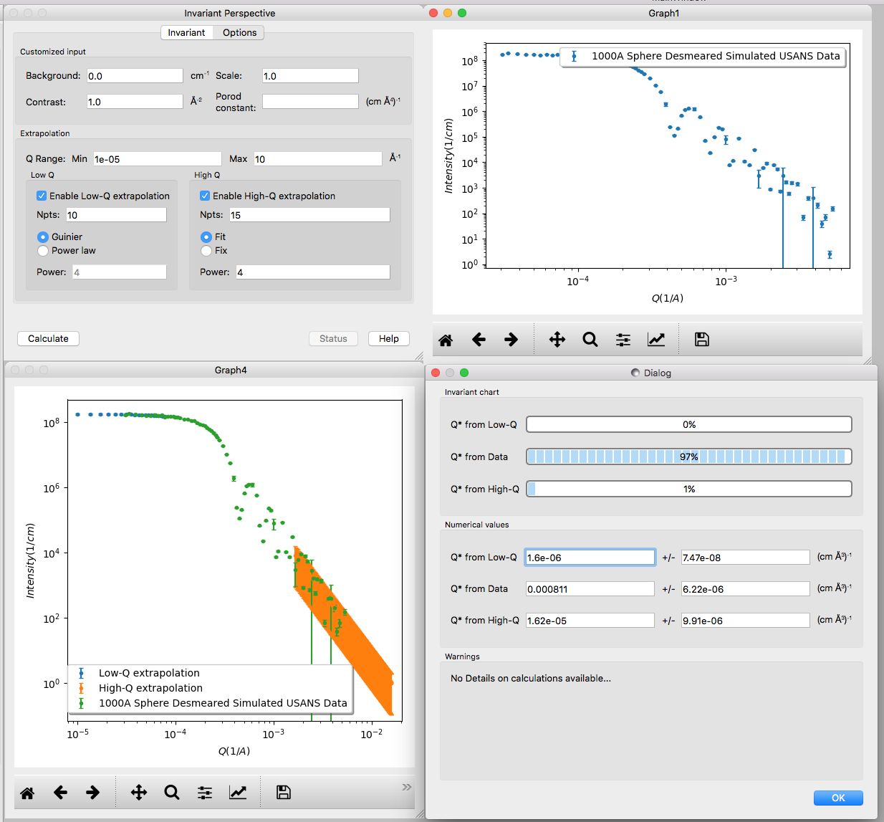
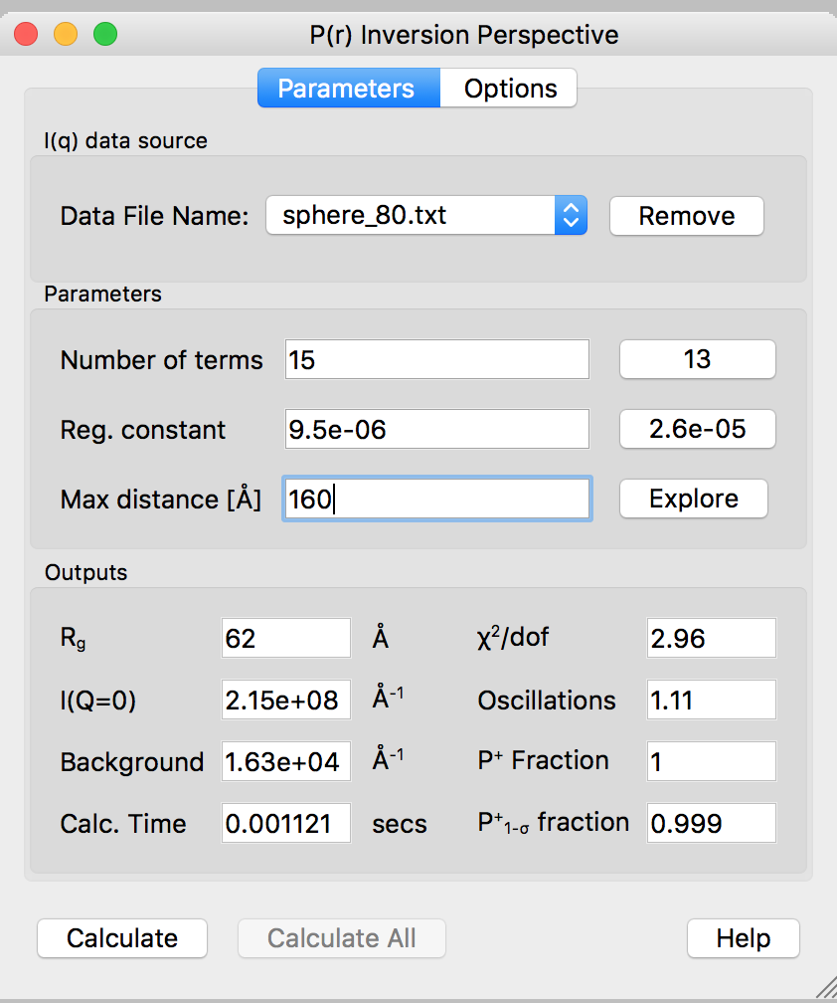
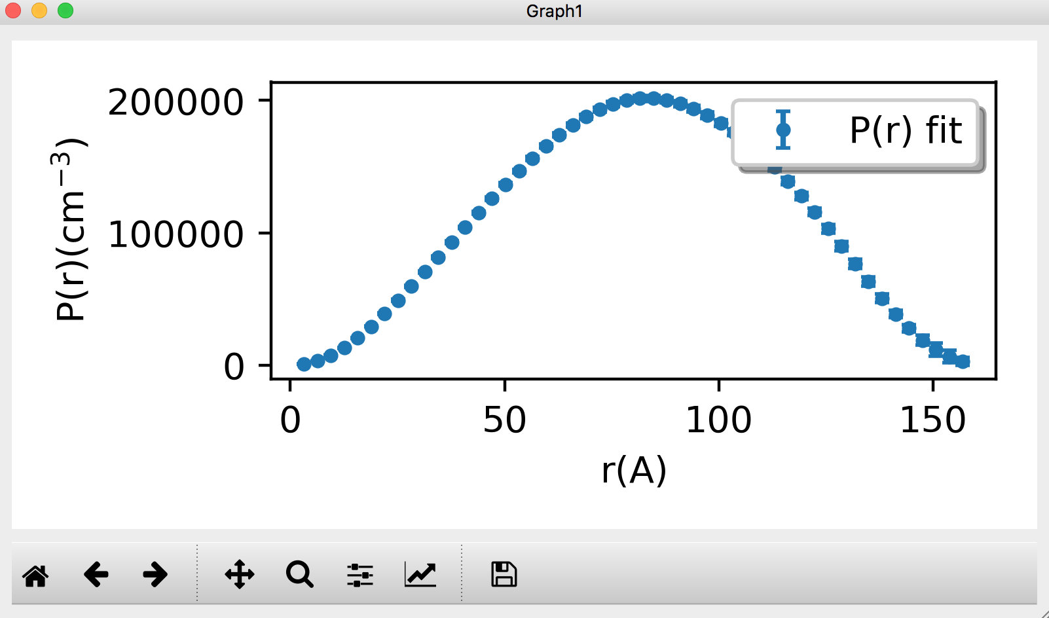
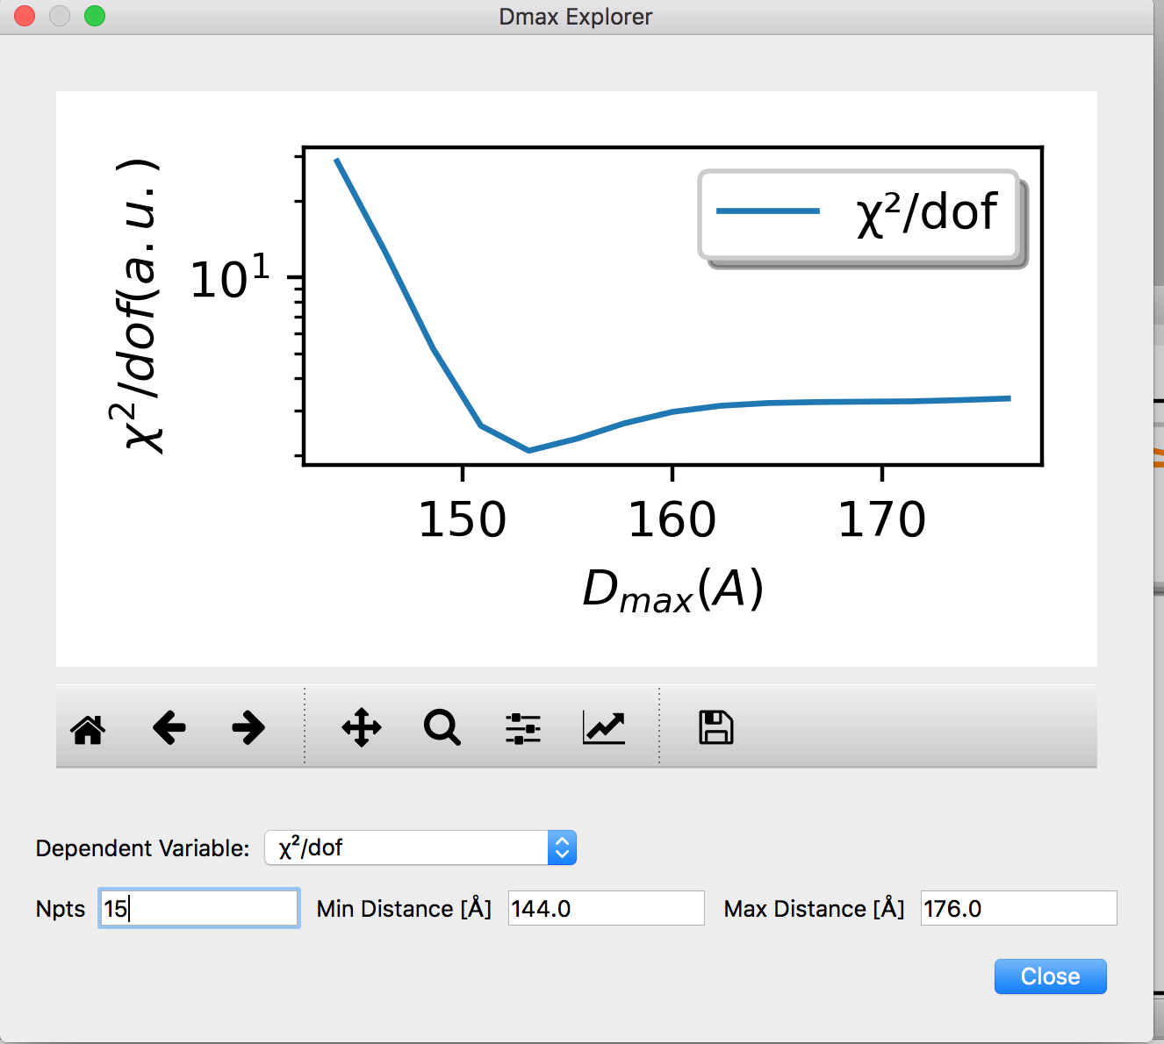
But what if we don’t know the model
Model independent analysis – Porod invariant
Real-space pair-distance distribution P(R) derived with Moore’s derivation

Slide 23
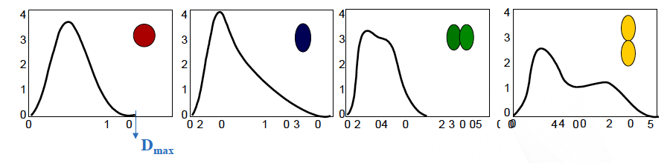
Pair-distance distribution function
P(r) Probability of finding a vector of length r between scattering centers
D_{max}
Credit: W. Heller, NX school 2019

Slide 24
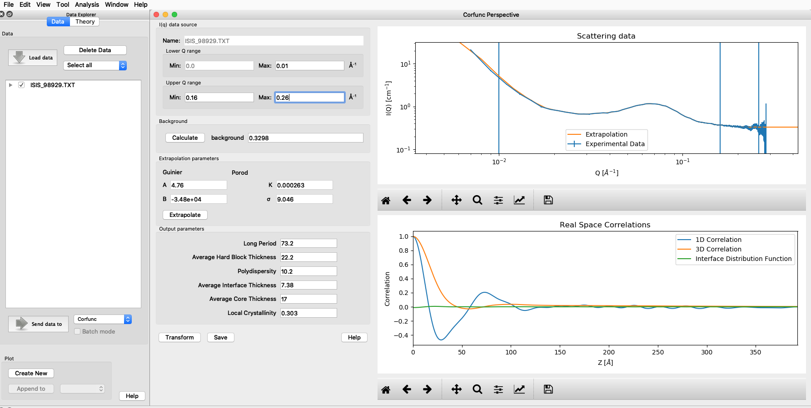
Correlation functions
An imaginary rod moving through the structure of the material
SasView returns both the one-dimensional ( Γ₁(x) ) and three-dimensional ( Γ₃(x) ) correlation functions

Slide 25
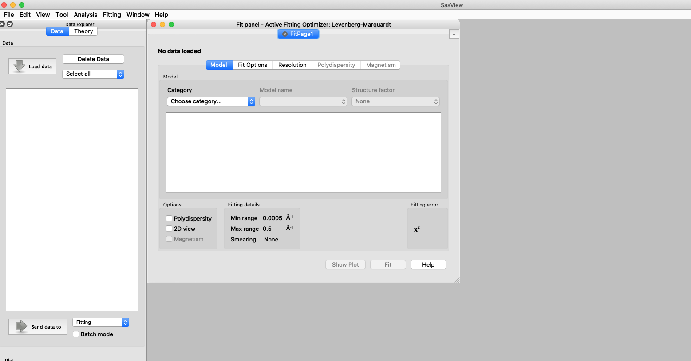
Other functionality
Tools
Analysis
Data Operation
SLD calculator
Density/Volume calculator
Slit Size Calculator
Kiessig Thickness Calculator
Q Resolution Estimator
Generic Scattering calculator
Orientation Viewer
Python Shell/Editor
Image Viewer
File Converter
Fitting
Invariant
Pr Inversion
Correlation Function

Slide 26
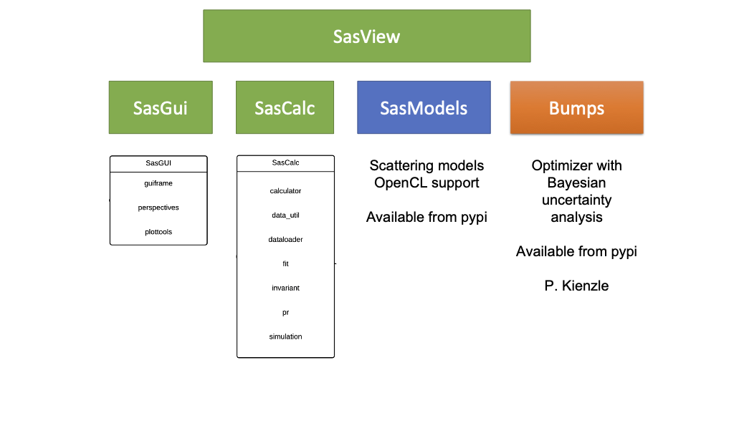
SasView architecture provides various user interfaces

Slide 27
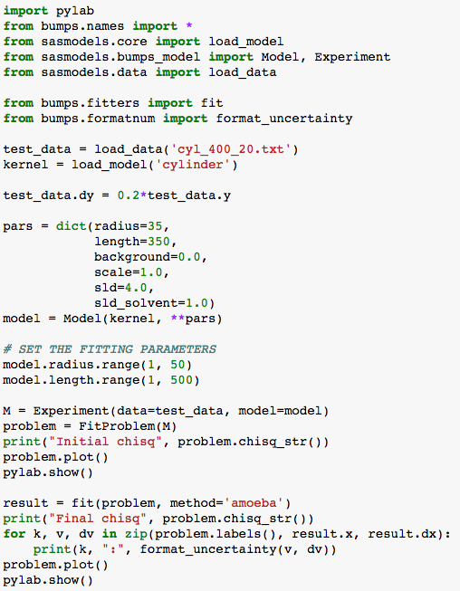
SasView can be run from python script
Direct use of samodels and bumps optimizer to fit 1D and 2D data
Scripts can be run of computer cluster
Fitting jobs can be defined from GUI and then detached
Before fit
After fit

Slide 28
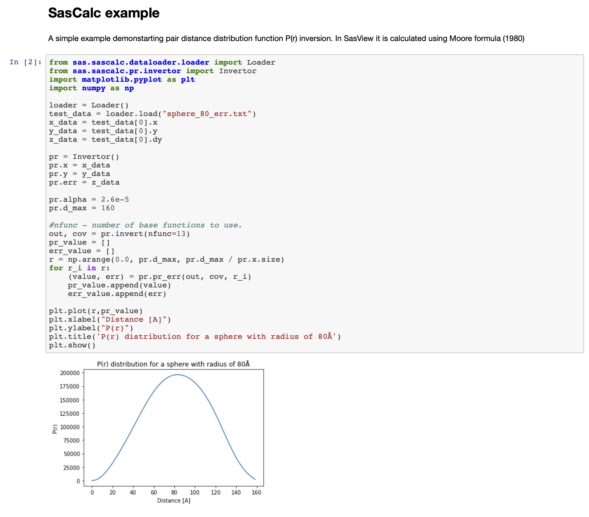
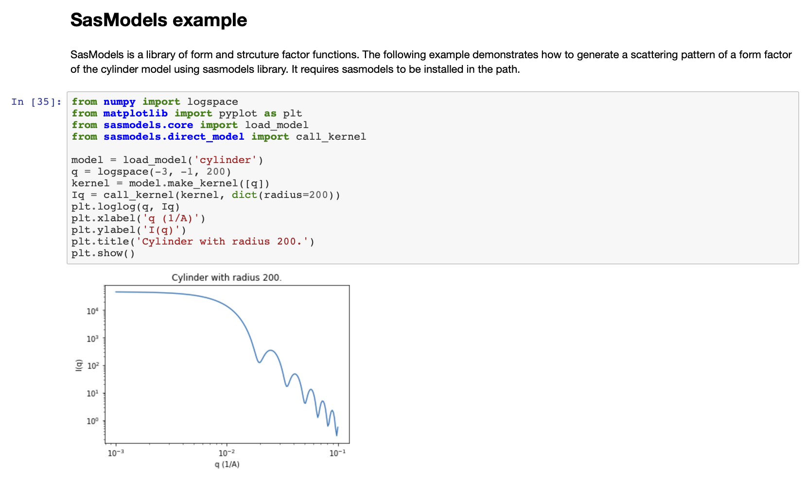
SasView can be run from Python script
https://github.com/SasView/sasview/wiki/DevNotes_DevGuide_GettingStarted

Slide 29
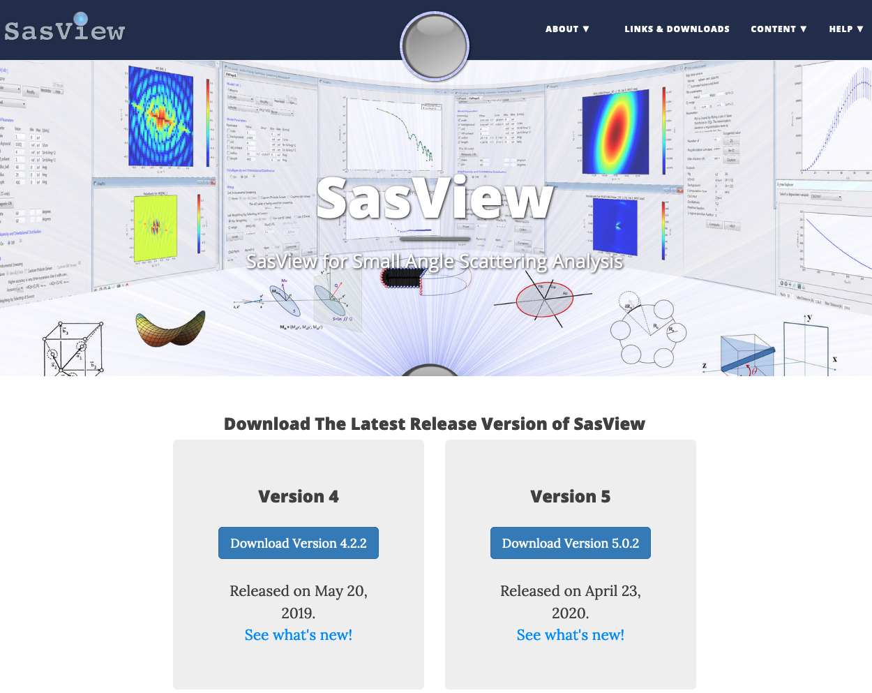
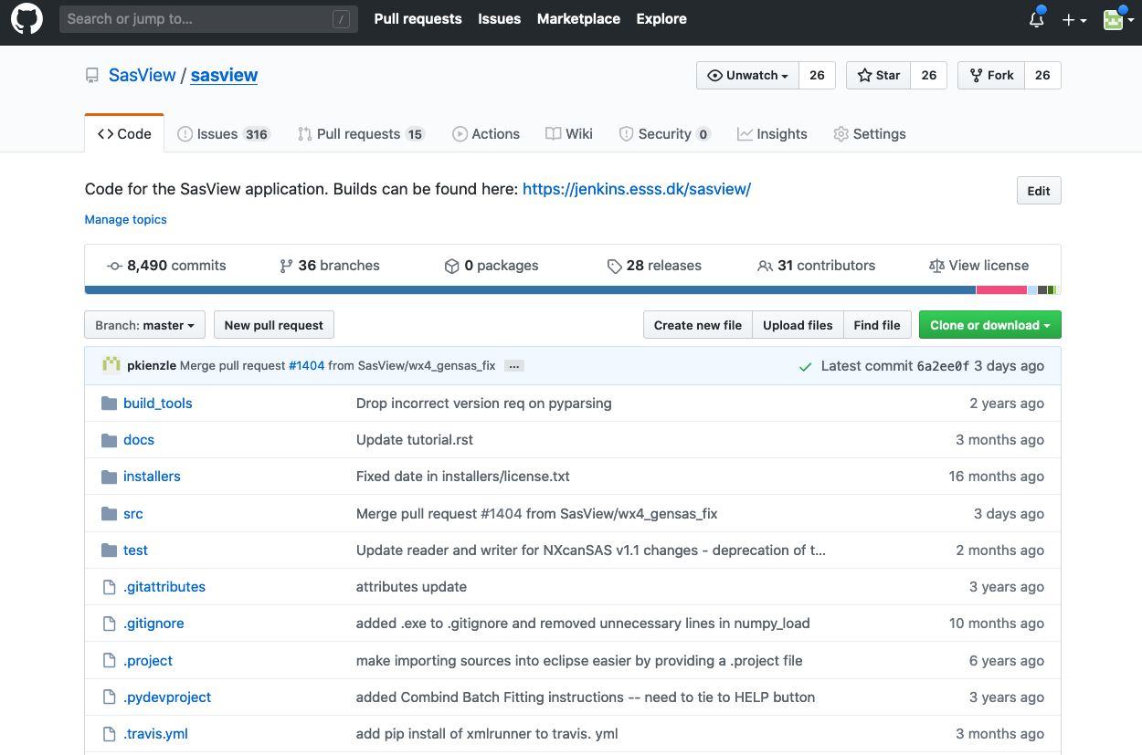
How to start using SasView?
sasview.org
https://github.com/SasView

Slide 30
SasView 5.0.2
Released in April 2020
New features/improvements
sasview # 1355 SasView 5.0 lacks file conversion option in tool menu
sasview # 1480 Added enumeration of plots in the Windows menu, with raising/setting
sasmodels # 211 Reparameterize existing model.
sasmodels # 390 Re-describe Source intensity in model parameter tables
sasmodels # 382 Doc gen speedup, improved random model generation and minor fixes
Bug Fixes
Fixes sasview # 1455 5.0.1 load project generates a second FitPage1
Fixes sasview # 1499 Ess gui 1355 file converter
Fixes sasview # 1501 Update 5.x documentation for Corfunc
Fixes sasview # 1431 When loading plugin model with a spurious unicode character plugin editor crashes
Fixes sasview # 1138 Check package versions in yaml files and setup.py
etc…

Slide 31
SasView RoadMap
Roadmap mid 2020 to mid 2021
Version 5.1
Complete beta approximation
Complete SasView paper
Begin refactor on constraints/sim fits
Start on use P or S array to do P*S … or I/P?
Starton Oriented 1D cuts fitted
Start Advanced “how to fit my data” tutorial
Start work on General Ornstein Zernike solver
PRISM incorporation
McSAS integrated
Architecture manual complete
Identify “custom workflows”
Custom model editor features added like including compare.py integration
Headless operation for realtime analysis started
sascalc separation started
Start work on time-of-flight resolution function

Slide 32
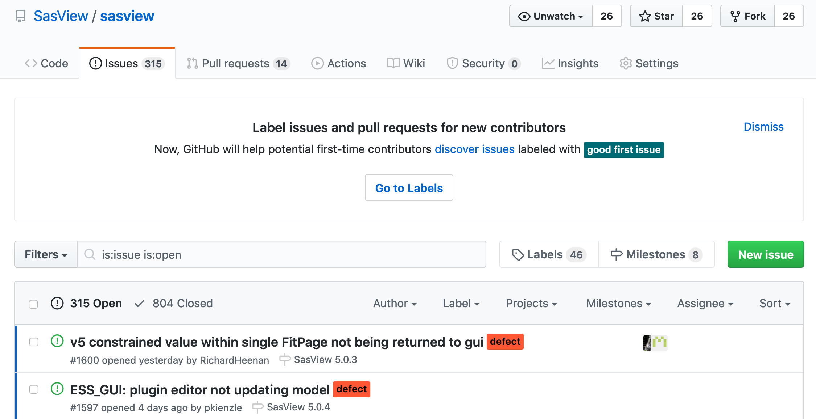
Day-to-day issues
https://github.com/SasView/sasview/issues

Slide 33
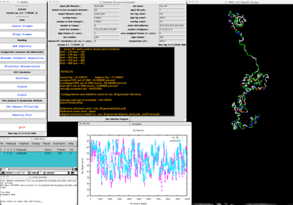
What SasView cannot do
Molecular molecular and ab initio models are beyond the scope
http://www.smallangles.net/sassie/SASSIE_HOME.html
https://www.embl-hamburg.de/biosaxs/software.html

Slide 34


Time-resolved SAXS captures virus capsid assembly
?
Time
Oliver R., Potrzebowski W., Najibi M., MN Pedersen, L Arleth, N Mahmoudi, I Andre (under review)

Slide 35


Capsid assembly proceeds through two intermediates
SasView helped out in the initial analysis
For final state we have mixture of capsids
Parameter | Value
Weight Sp240 | 0.55±0.03
Weight core shell sphere | 0.45±0.05
Core radius [Å] | 172±10
Shell radius [Å] | 30±4
Oliver R., Potrzebowski W., Najibi M., MN Pedersen, L Arleth, N Mahmoudi, I Andre (under review)

Slide 36



Education and outreach
Website (www.sasview.org)
Documentation
Written Tutorials
Video Tutorials (YouTube)
Taught courses
Scattering schools
University courses
E-learning
Twitter
Slack
Mailing Lists
Marketplace
Camps and other events

Slide 37

Education and outreach
Website (www.sasview.org)
Documentation
Written Tutorials
Video Tutorials (YouTube)
Taught courses
Scattering schools
University courses
E-learning
Twitter
Slack
Mailing Lists
Marketplace
Camps and other events
All the work of ISIS Summer Student Lewis O’Driscoll

Slide 38


Do you want to learn more?
More training and events to come
Bootcamp (from basic use to becoming core developer) https://github.com/SasView/documents/blob/master/Training/SasView_Boot_Camp/syllabus.md
”Hackathon” (virtual focussed event)
Code camp X (most likely at Caltech)
Follow news at:
www.sasview.org
Mailing list (users@sasview.org)
https://twitter.com/SasView

Slide 39




Come to work with us!
It is not all about coding!
Things people are saying about SansView/SasView
‘SansView is a very helpful tool, very complete and easy to use’ - Niki
‘I want to thank you for this amazing software. It’s UI and options make the interpretation of spectra easier and faster’ - Philippe
‘I really like the SasView software’ - Martin
‘I have been using SasView as my software of choice for fitting SANS data, and I have been very happy with the software’ - Greg
‘I have found SasView very easy to use and the batch fit function is a wonderful time saving tool. I can finally stop making painful excel macros!’ - Andrew
‘I am a new user of SasView and I think it is a very useful and practical tool’ - Arnaud
‘Within 30 seconds…I am completely converted to SasView!’ - Mike
‘Thank you for creating and maintaining SasView. It is an incredibly helpful tool, and I use it regularly’ - Pasha
‘All the best and thank you again to carry on such a good job on SasView’ - Niki
‘Ooooh NICE PROGRAMME!! Hours of fun!’ - Stuart
‘I love such amazing software so much. It help our researches a lot.’ - Po-Wei

Slide 40
Thank you for listening

Slide 41



How do we work?
Open, Collaborative, Community Development
Code is open source and publicly hosted at Github
Released under BSD 3-clause license
Bug and Enhancement Ticket System
Bi-weekly developer calls
Code Camps
5 Year Roadmap
Model Marketplace
DOI for each release
Code Hosting, Task and bug tracking, and developer/user wiki
Github
Model Marketplace for users to share their models
marketplace.sasview.org
Automated Builds
build.sasview.org
41

Slide 42

Contrast matching
Selective deutaration of system parts

Slide 43
Contrast matching
ecoR124I
Kennaway CK(1), Taylor JE, Song CF, Potrzebowski W, Nicholson W, ... Roberts GA, Artero JB, Bujnicki JM, Trinick J, Kneale GG, Dryden DT. NAR(2012)

